Slide 1
Peace Requires
Cooperation
Trust
Justice
Equality
Wealth
Low Fertility
Housing, food, health care
Transportation
Energy
Education

Slide 2
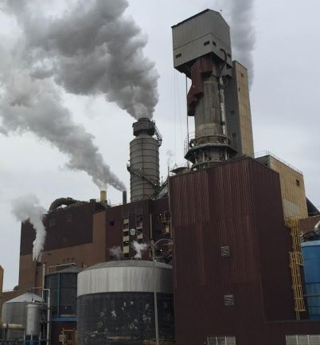
Factory Inputs
Factory
Labor
Time
Space
Energy
Raw materials

Slide 3
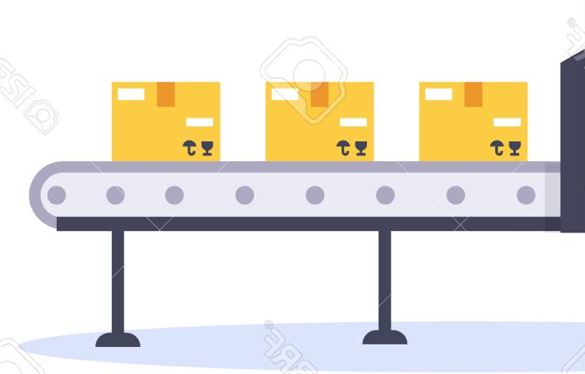
Big Factory Outputs
Factory
Labor
Time
Space
Energy
Raw materials

Slide 4
Personal Factory Outputs
Labor
Time
Space
Energy
Raw materials

Slide 5
Big Factory Ecology
Designer
Design
Build process
Marketer
Big
Factory
Labor
Customer
Store
Product
Time
Space
Manager
Energy
Waste
Raw materials
Trash

Slide 6
Personal Factory Ecology
Design
Build process
Designer
Internet
Labor
Customer
Product
Time
Space
Solar Panel
Energy
Waste
Raw materials

Slide 7
Protein Factory Ecology
DNA
RNA
Design
Build process
Evolution
Designer
Cytoplasm
Internet
Personal
Factory
Chemistry
Labor
Protein
Ribosome
Customer
Product
Time
Space
Solar Panel
Energy
Waste
Raw materials
ATP
Food
Amino Acids

Slide 8
Personal Factory
Advanced 3D Printer with more:
Materials
Processes
Plastic
Metal
Ceramics, Glass
Liquid
Gels/soft material
Electronics
Cloth
Additive
Subtractive (drills, laser)
Folding (origami)
Casting
Assembly (pick and place)
Growing
Chemistry/Biotech

Slide 9
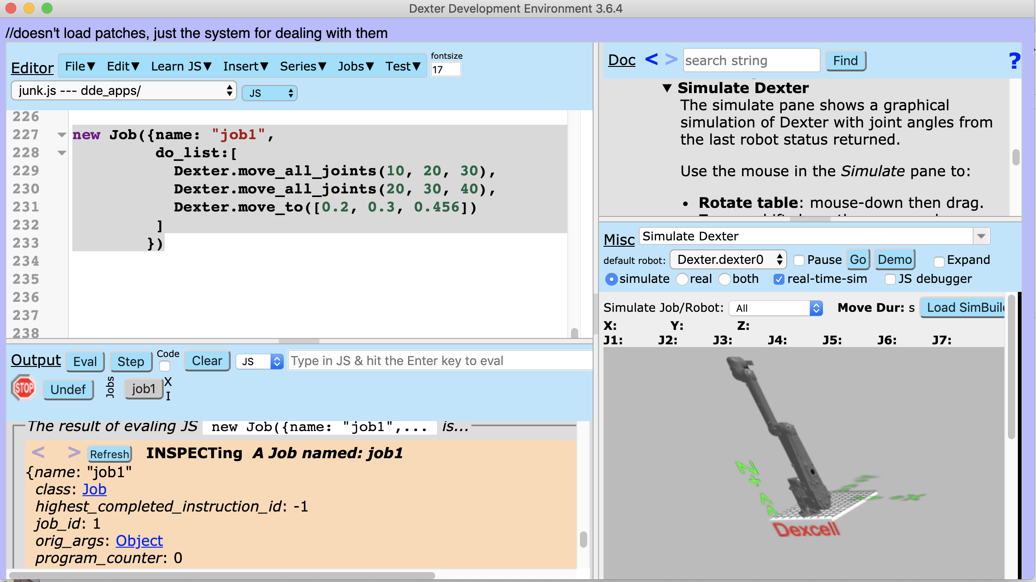
Dexter Development Environment
for programming robots.

Slide 10
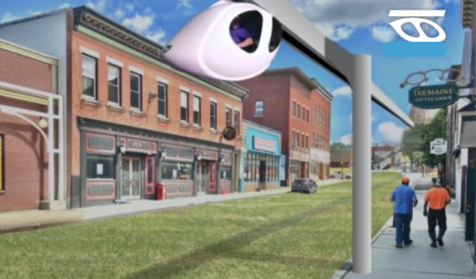
Personal Rapid Transit
for inter-village transportation
Cheaper (often)
Faster
Safer
Smaller
Lighter
More Efficient
Cleaner
Quieter
Calmer

Slide 11
Government Types
1. False freedom (chaos, individual freedom)
2. Absolute authoritarianism
3. Competitive authoritarianism (Top 9 most populous countries plus most others have this form of government in 2020)
4. Voteocracy (rare Scandinavia?)
5. Rational freedom (Collective freedom, one example: Reasonocracy)

Slide 12
Reasonocracy
Requires Well Motivated People
Requires Reason, not power-based Decision Making
Requires Complexity Management
Requires citizens educated in Cooperation
Requires sufficient Wealth For All

