Slide 1
How Science Can Enable a More Cooperative Future
Henry Lieberman¹ and Christopher Fry²
UNESCo Cross-Cultural Ambassadors for Peace
¹ MIT Computer Science & Artificial Intelligence Lab
² Haddington Dynamics
{lieber, cfry}@media.mit.edu
whycantwe.org
Notes:
I want to thank Josh van Zak and Edna Bravo for yesterday’s talks. I couldn’t imagine a better lead-in to our talk today.
As a kid in NY, every year we took a field trip to the UN. This is a fulfillment of a dream for me.
I’ll start out with a diplomatic success story. It’s about two national leaders that successfully negotiated a peace treaty.

Slide 2
What are the biggest problems we face today?
Notes:
When I talk to activists, they say: You scientists think everything’s a technical problem.
We need both technical and social solutions.
So, we are going to get into technical stuff. This is the STEM part of the program. We are going to talk about math, and about robotics as well as politics and economics.
After the break, we’ll have a discussion, so think about questions or comments.
Then we’ll get into the technical deails.

Slide 3
What are the biggest problems we face today?
Coronavirus pandemic
Economic collapse
Poverty and inequality
Climate crisis
War
Pollution
Political gridlock
Authoritarianism
Discrimination
Food supply
Crime
Justice
Education
Transportation
Health care
Mental health
Domestic violence
Notes:
When I talk to activists, they say: You scientists think everything’s a technical problem.
We need both technical and social solutions.
So, we are going to get into technical stuff. This is the STEM part of the program. We are going to talk about math, and about robotics as well as politics and economics.
After the break, we’ll have a discussion, so think about questions or comments.
Then we’ll get into the technical deails.

Slide 4
We can achieve peace and prosperity in our lifetime
Notes:
Peace isn’t just the absence of war.
The UN goals are as good a statement as any of the broad goals of peace.
I’m going to make the bold statement that we can achieve every one of them in our lifetimes. Really.

Slide 5
But not how you might think…
Not just via better technology…
(though we do need better tech – stay tuned!)
Not by electing “good leaders”
Not by peace treaties
Not by successful companies

Slide 6
But not how you might think…
Not just via better technology…
(though we do need better tech – stay tuned!)
Not by electing “good leaders”
Not by peace treaties
Not by successful companies
… but by people learning to become more cooperative with one another

Slide 7
Most of today’s social problems are due to a failure to cooperate
The tradeoff between cooperation and competition is fundamental to solving society’s problems
Technological advances
Increase the value of cooperation
Decrease the value of competition
Today’s institutions are set up for competition:
Competition between products, companies in the economy
Competition between candidates, parties in government
Competition between nations, ethnicities, religions, etc. etc.
How do we make our institutions more cooperative?

Slide 8
Well, will people ever learn to cooperate with each other?
Pessimist’s answer: No
Our answer: YES! (but it’s gonna take some doing)
What do you believe about “human nature”?
Intrinsic vs. Extrinsic Motivation
Scale up interpersonal and small-group cooperation

Slide 9
Pessimistic scenarios imagine pouring tech into our present systems
Capitalist or Socialist economics
(US-style) Democracy (voting, parties, exec/legislative/judicial…)
Nation-state international order
… but those systems were designed for their times: 18th and 19th centuries
Let’s redesign these systems for the 21st Century!

Slide 10
The curriculum
What keeps us from getting along?
Math, evolutionary theory
Does human nature allow us to get along?
Psychology
Can government help us get along?
Reasonocracy
Can we get along economically?
Makerism
What about…
Education, Transportation, Defense, Justice, etc. etc.
Notes:
When I talk to activists, they say: You scientists think everything’s a technical problem.
We need both technical and social solutions.
So, we are going to get into technical stuff. This is the STEM part of the program. We are going to talk about math, and about robotics as well as politics and economics.
After the break, we’ll have a discussion, so think about questions or comments.
Then we’ll get into the technical deails.

Slide 11
Vicious and Virtuous Cycles

Slide 12
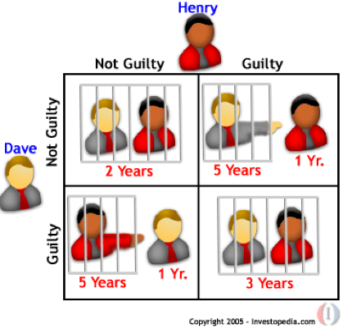
Scarcity is the driver of competition
The Prisoner’s Dilemma
Mathematical model of the tradeoff between cooperation and competition
The Ultimatum Game
Model of sharing of results of cooperative effort
Positive-sum Evolution
Evolution selects for positive-sum outcomes

Slide 13
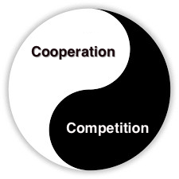
The Central Argument (1 of 7)
The tradeoff between cooperation and competition determines whether our society will succeed or fail

Slide 14
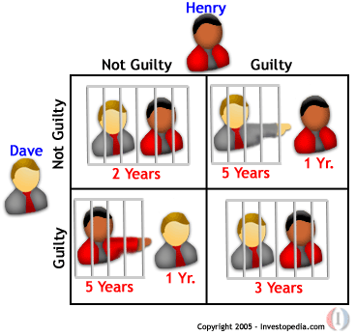
The Central Argument (2 of 7)
Many social situations can be described by the Prisoner’s Dilemma.
It seems like you should compete…
… but actually, you should cooperate

Slide 15
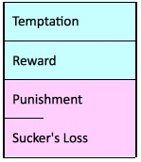
The Central Argument (3 of 7)
Scarcity promotes competition
Abundance promotes cooperation
(and vice versa)

Slide 16
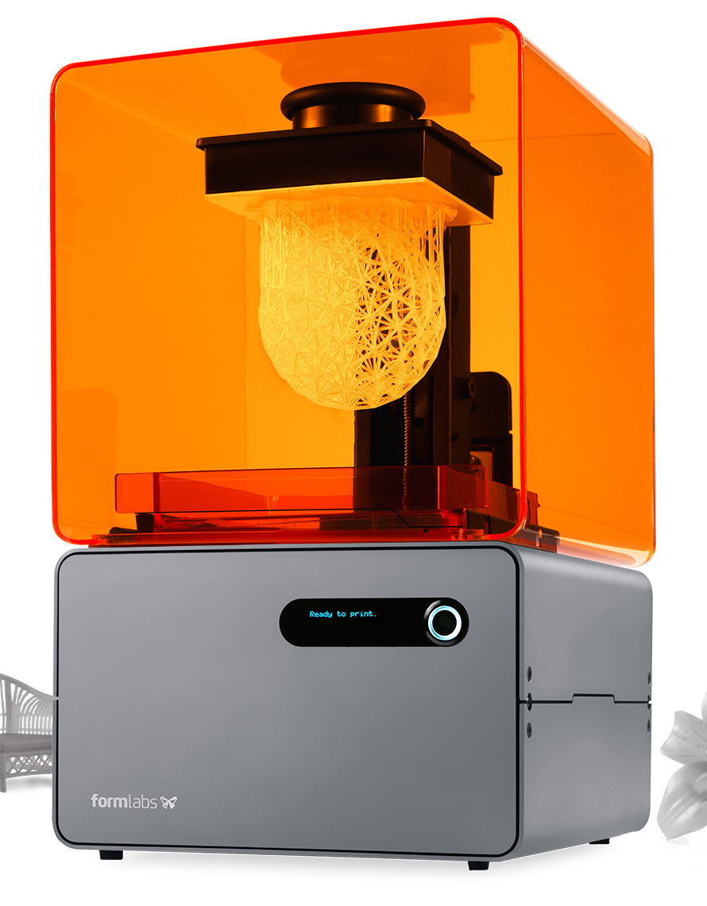
The Central Argument (4 of 7)
Artificial Intelligence
and Personal Manufacturing
can solve scarcity

Slide 17
The Central Argument (5 of 7)
Our political & economic systems were developed for competitive scarcity.
They must change for the new era of cooperation and abundance!

Slide 18
The Central Argument (6 of 7)
What replaces Capitalism/Communism?
Makerism
(democratize the means of production)

Slide 19
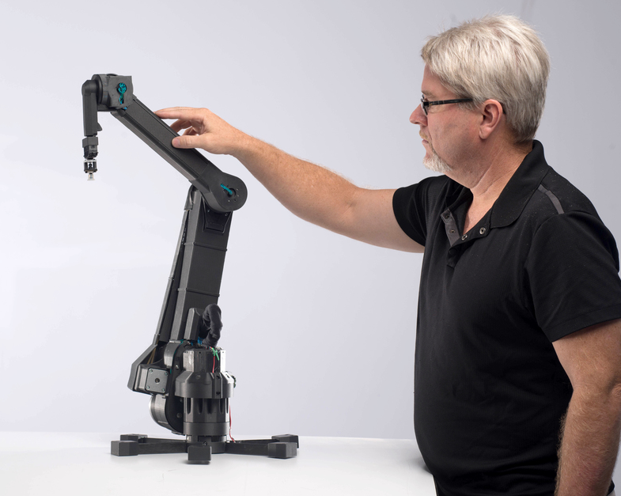
Makerism
Capitalism: Capital owns the means of production
Communism: Government owns the means of production
Makerism: Everybody owns the means of production
The means of production are:
3D Printers and Robots, not big factories
Key advance: When a 3D printer can make another 3D printer
AI Software, not bureaucracies and bureaucrats

Slide 20
The Central Argument (7 of 7)
What replaces US “Democracy”?
Reasonocracy
(cooperation inspired by the social processes of science)

Slide 21
Reasonocracy
Government inspired by the social principles of the scientific community
Science is organized for cooperation
No President, No CEO
No stockholders, no political parties, etc. etc.
Very little voting
Modern processes and tools for achieving consensus

Slide 22
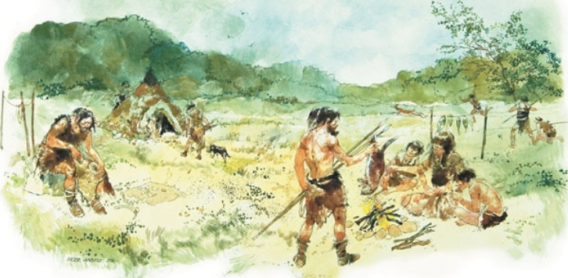
History of the world, log scale
Time | -100K years
Era | Hunter-Gatherer
Tech | Stones & Bones
Economy + Government | Tribalism
Interpersonal | Competition
Result | Blood

Slide 23
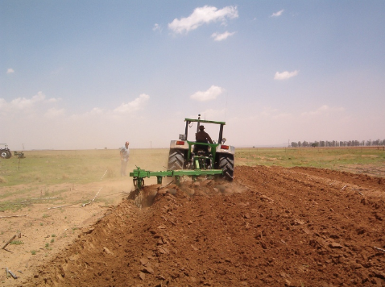
History of the world, log scale
Time | -100K years | -10K years
Era | Hunter-Gatherer | Agricultural
Tech | Stones & Bones | Plows & Cows
Economy + Government | Tribalism | Feudalism
Interpersonal | Competition | Competition
Result | Blood | Sweat

Slide 24
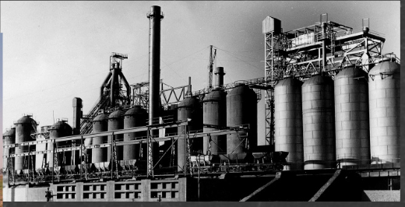
History of the world, log scale
Time | -100K years | -10K years | -100 years to Now
Era | Hunter-Gatherer | Agricultural | Industrial
Tech | Stones & Bones | Plows & Cows | Jobs & Mobs
Economy + Government | Tribalism | Feudalism | Capitalism + Democracy
Interpersonal | Competition | Competition | Competition
Result | Blood | Sweat | Tears
Notes:
Imagine it was about 1750. You saw it all coming, but it was hard to convince people….

Slide 25
History of the world, log scale
Time | -100K years | -10K years | -100 years to Now | +10 to +100 years
Era | Hunter-Gatherer | Agricultural | Industrial | Information Age
Tech | Stones & Bones | Plows & Cows | Jobs & Mobs | Machines & Genes (AI & Robots & 3DP & Biotech)
Economy + Government | Tribalism | Feudalism | Capitalism + Democracy | Makerism + Reasonocracy
Interpersonal | Competition | Competition | Competition | Cooperation
Result | Blood | Sweat | Tears | Peace, Prosperity

Slide 26
Now what should we do?
Communicate an optimistic vision for the future
Help people to understand that we're in a transitional society
Help design the new society
Help design the transition so that nobody gets hurt
… and we’ll all live happily ever after!

Slide 27
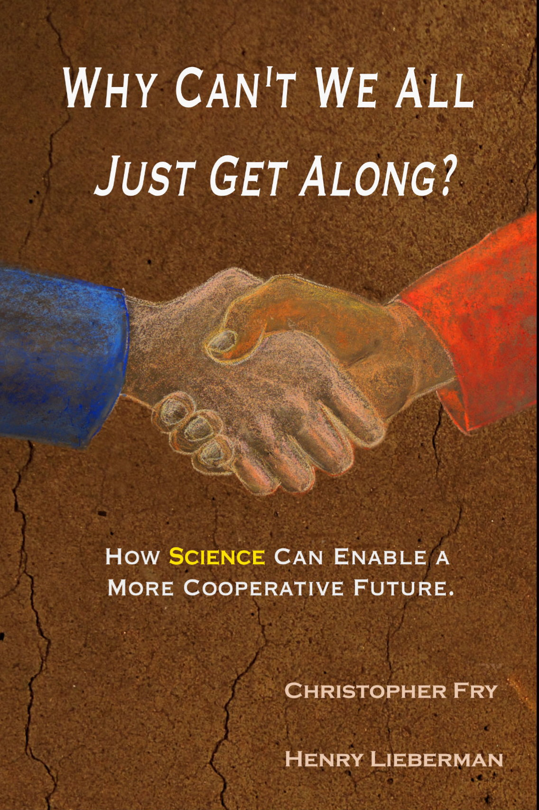
The full story with five part harmony and TEDx talk
http://www.whycantwe.org
Book (e-book and hardcopy)
TEDx talk (12 minutes), essays
You are invited to our MIT course!
RSVP: lieber@media.mit.edu
Mon and Wed, 2 Sept 2020 – 14 Dec 2020
15:00-16:30 US EDT = 19:00-20:30 UTC
Notes:
Because this is a special group, we would like to make a gift to you of the book.
Coupon code: Makerism
We are teaching a course in the fall at MIT starting in September.
Like everyplace else, we will be teaching remotely.
So we invite you to join our course, for free. It is 2x/week, 90 min/week, on Zoom, just like now.
Send us email if you would like to join us.

Slide 28
Mailing Lists
Two mailing lists for this course:
scicoop-fall-2020@mit.edu:
All participants plus instructors
Everyone may post -- we encourage general questions / class-wide discussion!
Course announcements will be sent by instructors
scicoop-fall-2020-staff@mit.edu:
Just goes to course staff (Instructors - Henry + Fry / TA's - Esther, Blake)
Submit homework here (for now)
Ask private questions to the instructors

