Slide 1
Does Human Nature Allow Us to Get Along?
Henry Lieberman and Christopher Fry
MIT Computer Science & Artificial Intelligence Lab

Slide 2
How could two people with different views ever agree on anything?
I believe X
You believe (not X)
Power: If I have more power than you, I could insist that you accept X
Compromise: We could ”split the difference” X/2
Trade: I get X by giving you Y
Adjudication: Outsource the decision to a third party (or algorithm)
Persuasion: I could convince you that X was a good idea

Slide 3
Goal Stacks
”Why are we in the car, Daddy?” To go to the airport
“Why?” To take an airplane
“Why?” To go on vacation
“Why?” To have fun

Slide 4
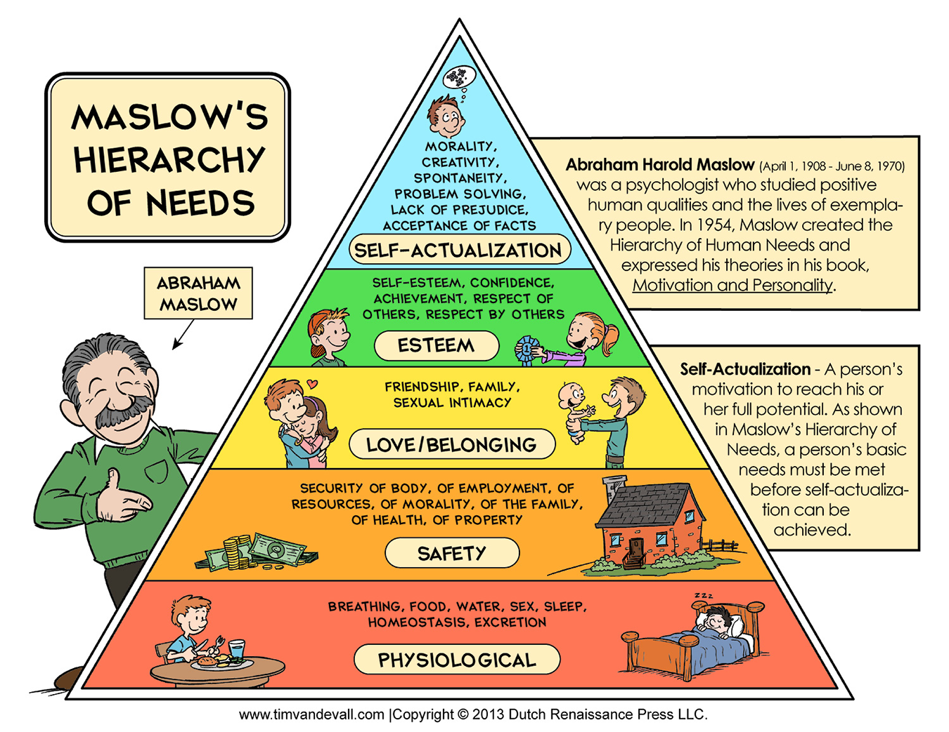
Maslow’s Hierarchy of Needs

Slide 5
Alignment of goal stacks
Bo Jiden
Goal: Have a good life
Subgoal: Have enough food to eat
Subgoal: Good environmental conditions necessary to grow food
Fact: Environmental regulations make the environment healthier
Action: Vote for environmental regulations
Ronald Dump
Goal: Have a good life
Subgoal: Have enough food to eat
Subgoal: Have enough money to buy food Have a good job to get the money
Fact: Regulations result in fewer jobs
Action: Vote against environmental regulations

Slide 6
Negotiations
”Let’s hammer out our differences”

Slide 7
Competitive vs. Cooperative Negotiation
Instead of looking for differences and debating differences
Work UP the goal stack til you reach common goals
Then, work down til you find mutually acceptable ways of achieving common goals
Rosenberg: Differences of positions indicate a need that isn’t being met
Find out what the need is, acknowledge it
Expand the domain of discourse
Alternative ways of accomplishing goals
Innovation

Slide 8
Interpersonal relations
”The political is personal”
We need to study cooperation/competition at all scales
Does the answer lie in
Psychology
Religion
Politics, sociology, self-help books, ……
Boils down to
What is “human nature”?

Slide 9
Uncertainty about psychology
We don’t know enough about psychology to understand what causes people to cooperate or compete, do good or evil
Some combination of nature and nuture
Progress in psychology will go hand-in-hand with technological progress

Slide 10
Techniques that may be helpful
Harvard Negotiation Project, Getting to Yes series
Self-help books: Rosenberg, Nonviolent Communication
Positive Psychology, Cognitive-Behavioral Therapy
Meditation, mindfulness, yoga, (maybe some of) religion

Slide 11
Computational models of affect
Marvin Minsky: Society of Mind and The Emotion Machine
Roz Picard: Affective Computing
Cindy Mason, Emotion-Oriented Programming

Slide 12
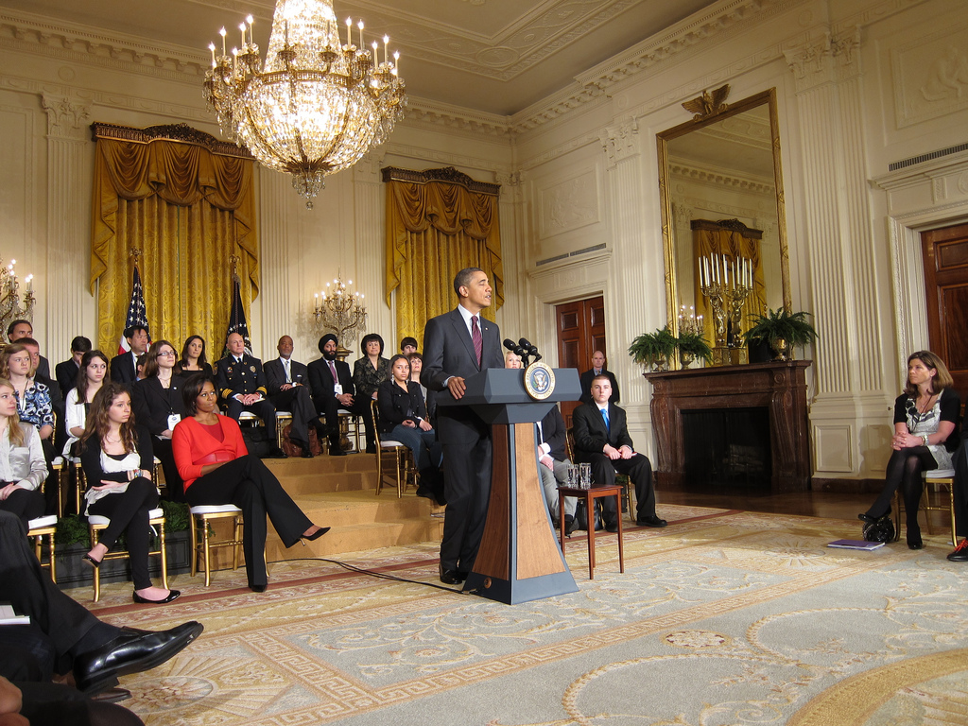
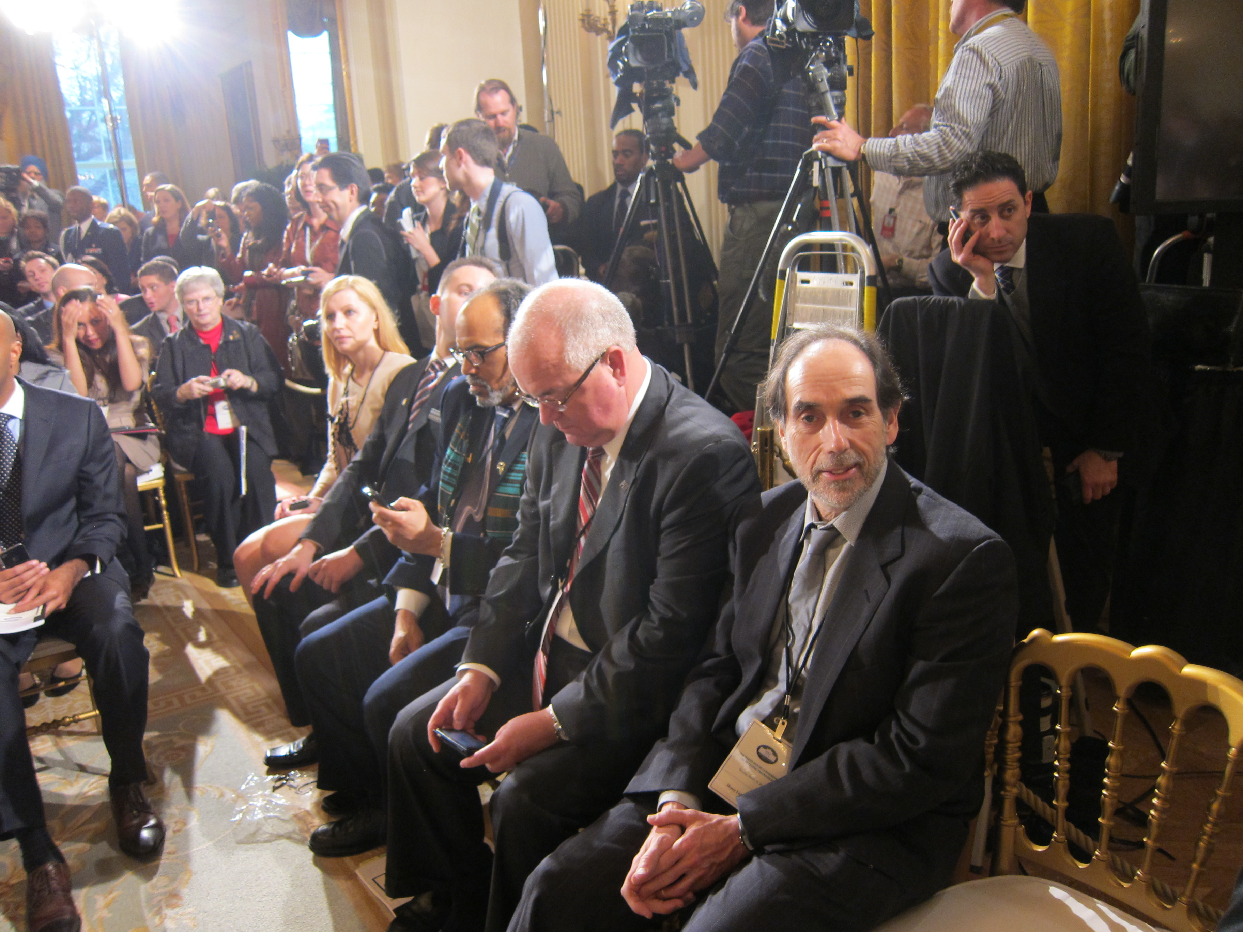
Cyberbullying

Slide 13
What causes bullying, criminality…?
Psychologists: Bullying is caused by insecurity, anxiety over social status
Criminals almost always have history of trauma
Greed is caused by fear
Aggression is caused by belief in “first strike”
These qualities may once have had evolutionary purpose, but now are counterproductive

Slide 14
Keeping up with the Post-Scarcity Joneses?
We could replace competition for material success with competition for social status
But why would we? What would be the point?
Would we have to “change human nature” to remove social status competition?
But today’s Captialism has incessant propaganda to encourage social status competition. Maybe that’s the problem.
Psychological studies say happiness not dependent upon $ beyond a very moderate point ($50-75K/year)

Slide 15
Obsessive-Compulsive Disorder (OCD)

Slide 16
Post-Scarcity society
… or maybe, Post-Competitive Society
Universal abundance will “take the pressure off” social conventions
How will social conventions change as a result of widespread abundance?

Slide 17
”We the Peoples”

Slide 18
Nationalism and Racism
Racism is a failure of science education
What makes people the same? A hell of a lot.
What makes people different? Not a hell of a lot.
”Race” not a scientific concept
Genetics is a scientific concept
Race absurd on the face of it
Why do we have “races” for skin color but not eye color or hair color?

Slide 19
Declaration of Independence of Cyberspace – John Perry Barlow

Slide 20
What’s the point of having “countries”?
Nationalism is just another form of racism
There aren’t any “different peoples” – There’s only homo sapiens
Military conquest?
Protection Racket
Language differences?
Cultural/lifestyle differences?
Experiment with different forms of governance?

Slide 21
Dissociation of culture from geography
If I knew where you were born, I’d know:
Your skin color and ethnicity
Your religion
What language you spoke
What food you ate
What music you listened to
Whom you married
Lots of other cultural things

Slide 22
Dissociation of culture from geography
Immigration based on cultural exchange, not necessity
Cultures will hybridize
Every place will become multicultural
No point in trying to buck these trends!

Slide 23
Genderism
(= Sexism)
To what extent are gender differences innate? Essentialism?
Is competition “a man’s thing”?
Are men more “motivated by competition”?
Will increased participation of women and minorities change the game as far as competition vs. cooperation?
Dissociate personality characteristics from gender

Slide 24
Rationality and Irrationality

Slide 25
Rationality and Irrationality

Slide 26
Rationality and Irrationality

Slide 27
Can some of us get along?
Cooperation works better in small groups than large groups
Why?
Personal relationships limited by Dunbar number 100-150
Can we study cooperation in small groups and “scale it up”?
Can technology help with scaling?

Slide 28
Current methods of group decision making are flawed
“Emote and Vote”
Everybody gets to speak
Then we take a vote
“Plea and Decree”
There’s an authority that makes the decision
Participants can try to influence the authority

Slide 29
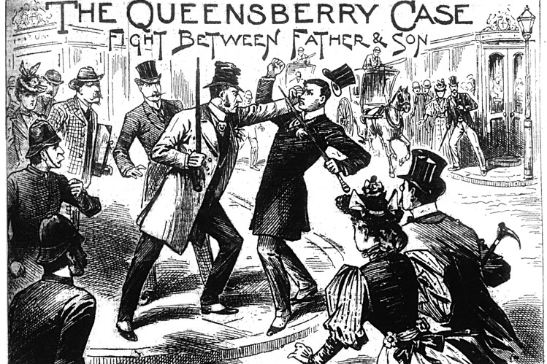
Marquis of Queensbury Rules
Rules for a “fair fight”
But it’s inevitable that someone is going to get hurt

Slide 30
Consensus Process
Develop sensible processes for making collective decisions
Based on cooperation rather than competition
Not dependent upon authority
Respectful of all participants
More fine-grained and proscriptive than processes like “Robert’s Rules of Order”
Studied in very different contexts:
Biz/Political negotiations, Counterculture communes and other intentional communities
Quakers, Alcoholics Anonymous, indigenous cultures

Slide 31
Consensus Process principles
Let everyone be heard, but insist upon respectful behavior
Seek consensus on process as well as consensus on content
Separate generating ideas from evaluating ideas
Permit and encourage innovation
Key is the role of skilled and disinterested facilitators
Seek agreement on the decision rather than agreement on the choice
Allow non-blocking objections

Slide 32
Consensus process weaknesses
There’s no consensus on consensus
”Endless meetings” – Time management
The reality of real-time
People can’t always “think on their feet”
Complexity management
But technology can help – stay tuned (Looking at you, Fry)!
Tough to do under pressure (= scarcity)
What to do about occasional defectors?
… but, further research in consensus process holds great promise for improving collective decision-making

Slide 33
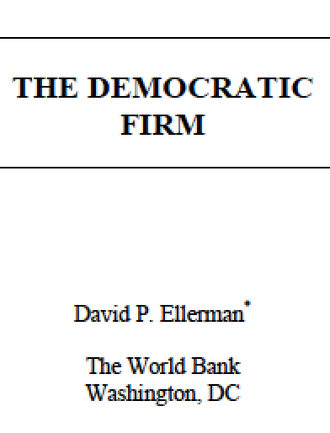
Cooperative Enterprise

Slide 34
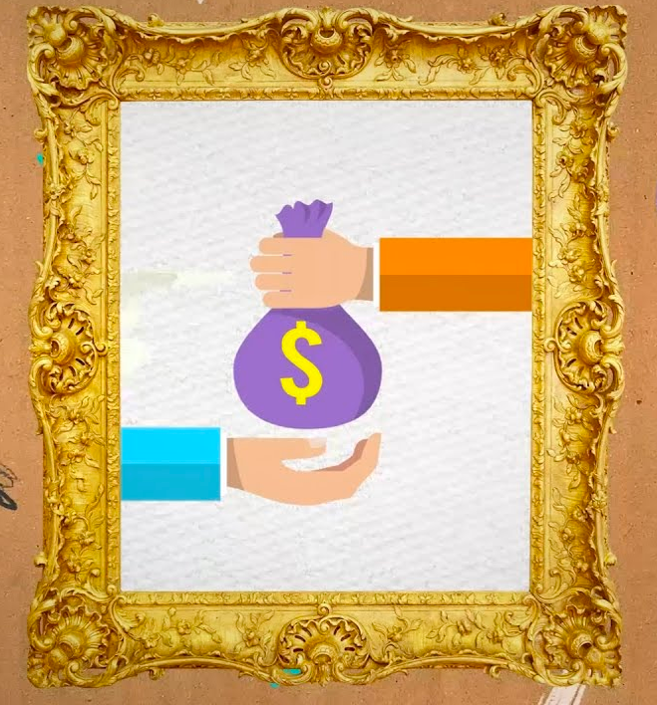
Lepper Children’s Drawing Experiment

Slide 35
Intrinsic vs. Extrinsic Motivation
Intrinsic Motivation
You do something for it’s own sake – like listening to music
Extrinsic Motivation
You do something for a reward, incentive, grades, pay, status, points in a game, …
Because there’s something else you want, not because of the activity itself
Intrinsic Motivation and Extrinsic Motivation inhibit each other

Slide 36
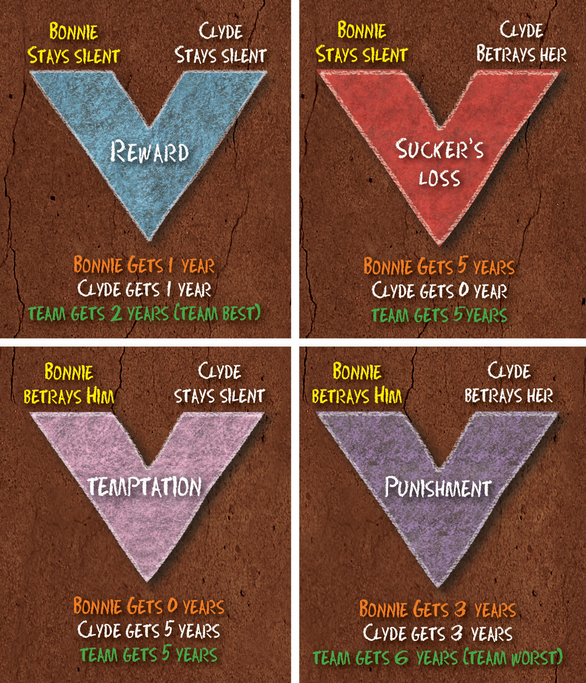
Intrinsic/Extrinsic Cooperation/Competition
Tradeoffs are related
Intrinsic motivation drives cooperation
Extrinsic motivation drives competition
Does “Competition motivate people”?

Slide 37
Causality, Motivation & Cooperation

Slide 38
Competition and motivation
Competition can only provide extrinsic motivation
Extrinsic motivation ”works” in the short term
Intrinsic motivation works in the long term
Competition tends to motivate “competitive personalities”
But turns off others

Slide 39
Two job offers
One: High paying, but boring work
Two: Low paying, but fulfilling work
Which do you take?

Slide 40
Research by Contest

Slide 41
The Bankruptcy of Incentive
Capitalism works by providing incentive to increase profit
Oppressive, because it is constantly bribing you to do things you don’t want to do
“What would people do all day if they didn’t have to work?”
Only 13% of workers say their work is “personally meaningful
40-60% of retirees satisfied with their life
What would it be like to design a society around intrinsic motivation?

