Slide 1
Can the Economy help us all get along?
Henry Lieberman and Christopher Fry
MIT Computer Science & Artificial Intelligence Lab

Slide 2
Why does a first-world worker make so much more than a third-world worker?

Slide 3
Why differences in income/wealth?
Hard work?
Education?
Value of product?
Topocracy !

Slide 4
Cooperation increases productivity as square of number of nodes
As tech advances, more of the value comes from “the network”

Slide 5
The world’s best biz model
Almost guaranteed to work!
Verified by major companies
Not illegal
But, …. some would consider it slightly unethical
The world’s first computer crime
Can you trust business not to steal from you?
Aggregation of microtheft

Slide 6
Well, what should happen to the surplus productivity?
Reward producers (incentive)
Credit assignment
Invest in future
Distribute to partcipants
Universal Basic Income (/ Wealth)

Slide 7
The Fundamental Theorem of Capitalism
(= “Fundamental Theorem of Welfare Economics”)
If everyone acts according to the economic incentives provided by Capitalism, the results will be, overall, the best for society
(not every single time/person, but “overall” relative to Communism, feudalism)
Does the Prisoner’s Dilemma contradict the FToC?
Incentives lead to disaster

Slide 8
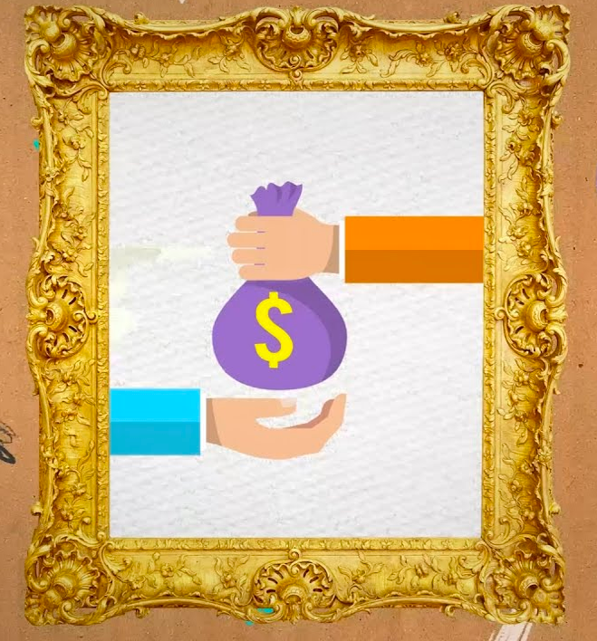
Lepper Children’s Drawing Experiment

Slide 9
Intrinsic vs. Extrinsic Motivation
Intrinsic Motivation
You do something for it’s own sake – like listening to music
Extrinsic Motivation
You do something for a reward, incentive, grades, pay, status, points in a game, …
Because there’s something else you want, not because of the activity itself
Intrinsic Motivation and Extrinsic Motivation inhibit each other

Slide 10
The Bankruptcy of Incentive
Capitalism works by providing incentive to increase profit
Oppressive, because it is constantly bribing you to do things you don’t want to do
“What would people do all day if they didn’t have to work?”
Only 13% of workers say their work is “personally meaningful
40-60% of retirees satisfied with their life
What would it be like to design a society around intrinsic motivation?

Slide 18
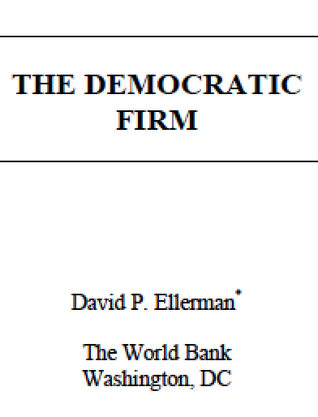
Cooperative Enterprise

