Slide 2
(Linguistic) Framing - Lakoff

Slide 3
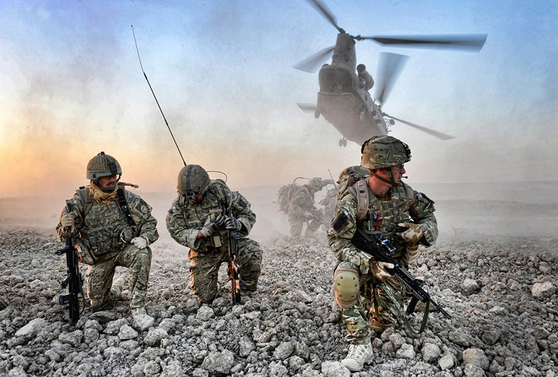
War Frame
Armies
Enemies
Battles
Victory
Surrender

Slide 4
Crime Frame
Crime
Perpetrator
Victim
Suspect
Evidences
Detectives
Trial
Prison

